Slide 1

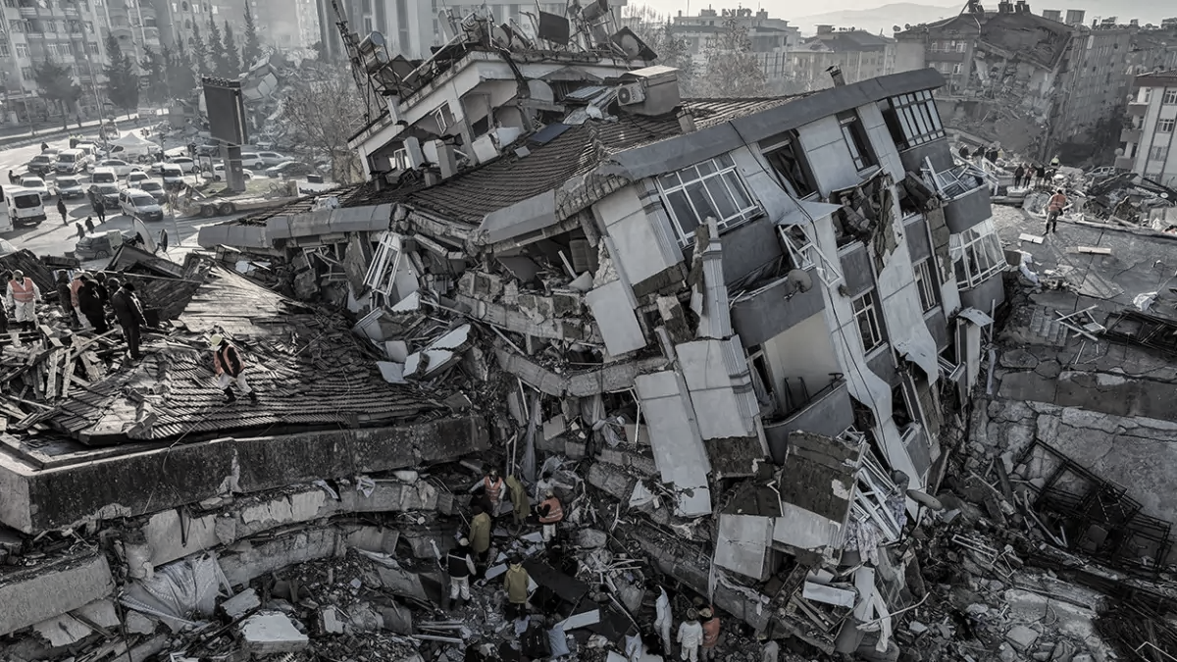
EARTHQUAKES AND TRENDS
Presented by:
Rachel Brimble, Jody-ann frazer, Rafed Mahbub and Ugochi Prince ajuobi
On
15th August 2023

Slide 2
INTRODUCTION
From ancient myths to modern science, earthquakes have captivated our imagination. Early humans pondered their origins, while scientific pioneers like John Michell and Robert Mallet paved the way for understanding seismic waves. The birth of seismology and the establishment of the USGS marked turning points, leading to today's advanced technologies that enable us to monitor, measure, and even predict these seismic events.
Welcome to "Earthquakes and Trends," where we embark on a journey through seismic history and modern data analysis. Earthquakes have long fascinated and terrified humanity, and we're here to unravel their mysteries using a wealth of information, including data from the USGS and other reliable sources.

Slide 3
BACKGROUND AND CONTEXT
According to long-term records (since about 1900), the USGS (United States Geological Survey) concludes we expect about 16 major earthquakes in any given year. That includes 15 earthquakes in the magnitude 7 range and one earthquake magnitude 8.0 or greater. In the past 40-50 years, our records show that we have exceeded the long-term average number of major earthquakes about a dozen times. The year with the largest total was 2010, with 23 major earthquakes (greater than or equal to magnitude 7.0). In other years the total was well below the annual long-term average of 16 major earthquakes. 1989 only had 6 major earthquakes and 1988 only had 7.
In this project, we delve into data to answer a vital question: Are earthquakes on the rise? By the end of this project, we aim to achieve the following outcomes:
A comprehensive understanding of global earthquake patterns and their relationship with tectonic plate boundaries.
Visual representations of earthquake occurrences with the ability to zoom in and explore details.
Insightful graphs depicting trends in earthquake frequency, aiding in the assessment of whether seismic activity is on the rise.
A foundation for further research into the causes of observed trends and their implications.

Slide 4
DATA SOURCES
The research data were obtained from the following public data sources for global occurrences:
https://www.usgs.gov/faqs/why-are-we-having-so-many-earthquakes-has-naturally-occurring-earthquake-activity
https://imgnew.outlookindia.com/uploadimage/library/16_9/16_9_5/IMAGE_1675913944.webp

Slide 5

RESEARCH QUESTIONS
The analysis was based on the urge to answer a critical question, ”Are earthquakes on the rise?”

Slide 6
DATA ORGANISATION

Slide 7
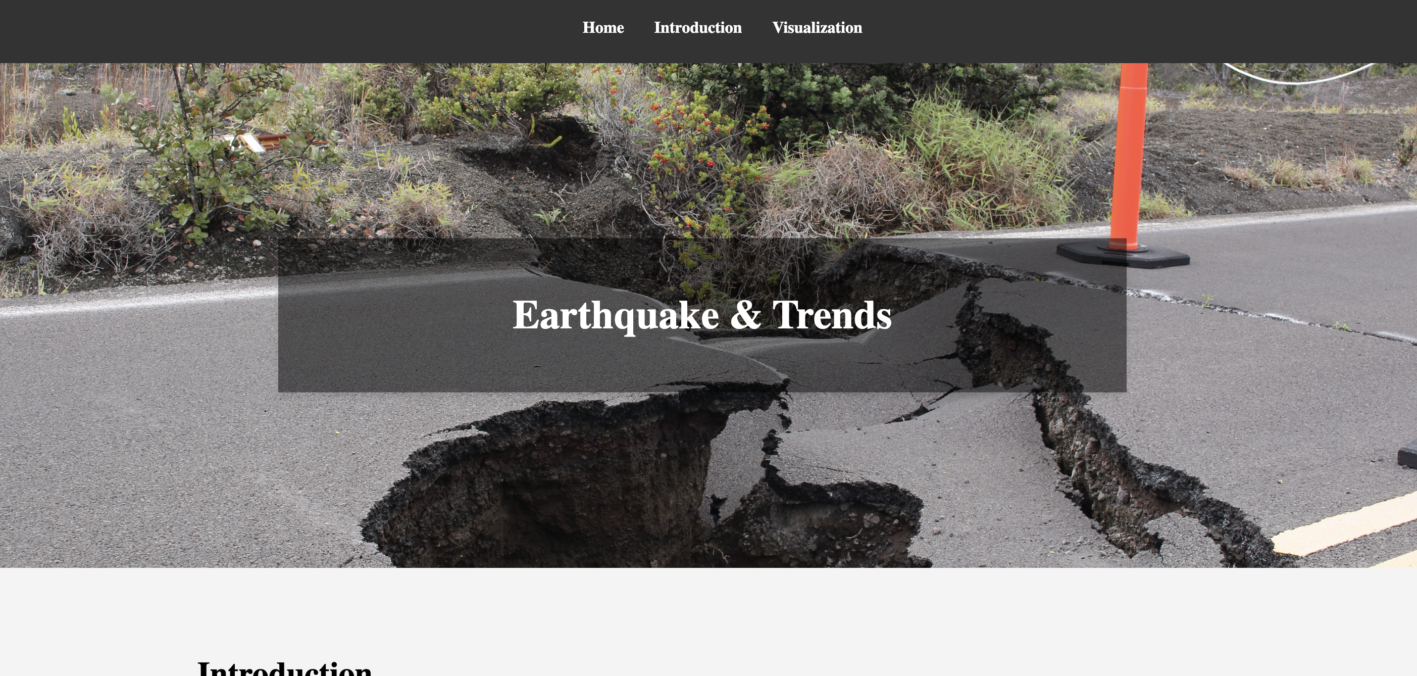
INTERACTIVE DASHBOARD STRUCTURE
We started off with creating a dashboard with navigation menu around the page for the research which would help viewing our visualisations and project summary easily using data analysis tools like html, css, javascript and other libraries. This was deployed to github pages which creates a link for anyone to visit the dashboard easily more like a website link in simple terms found below:
https://ugochiprince.github.io/Earthquakes/

Slide 8
EARTHQUAKE OCCURRENCES
We went further to then clean and scrape required data to create visualisations showing the different global views of earthquake occurrences by location on tectonic plates as well as clickable and popup map with zoom features as seen on the screenshots below and the dashboard

Slide 9
HISTORICAL VISUALISATION
Having gone through the global occurrences so far and affected locations, we further dug deeper to look at their trends using a plotly chart (screenshot shown below and plotly on dashboard) to answer the question posed; “ARE EARTHQUAKES ON THE RISE?"

Slide 10
ANALYSIS FINDINGS AND RECOMMENDATIONS

Slide 11

LIMITATIONS
As with every research analysis, there are always limitation. In this research we had limitations of :
Limited data and data sources
Time for indepth research

Slide 12

CONCLUSION
In conclusion, our analysis sheds light on the complex nature of earthquake trends. Understanding these patterns is crucial for disaster preparedness and mitigation. Future research could focus on predictive modelling and advanced monitoring technologies to enhance our ability to anticipate and manage seismic events.

